Slide 1
Celestial-Inertial UAS Navigation in a GPS-negative Environment
Austin Kreulach
University of Arkansas
Department of Computer Science and
Computer Engineering
Harrison Welch
Austin Peay State University
Department of Computer Science and
Information Technology

Slide 2
Presentation Structure
Importance of UASs
UAS Navigation
Non-GPS Navigation
Existing options
Celestial-Inertial Navigation
Notes:
Contains: What exactly we plan to speak about

Slide 3
Military Role of UASs
Surveillance
Map making
Enemy scouting
“Servicing the target”
Elimination of threats
Air support
Removing the human error from flying
Save the life of the operator
Improve operator efficiency
Reduce weight from removing human-bearing equipment
Operations limited by fuel, not sleep
Notes:
Contains: What exactly we plan to speak about

Slide 4
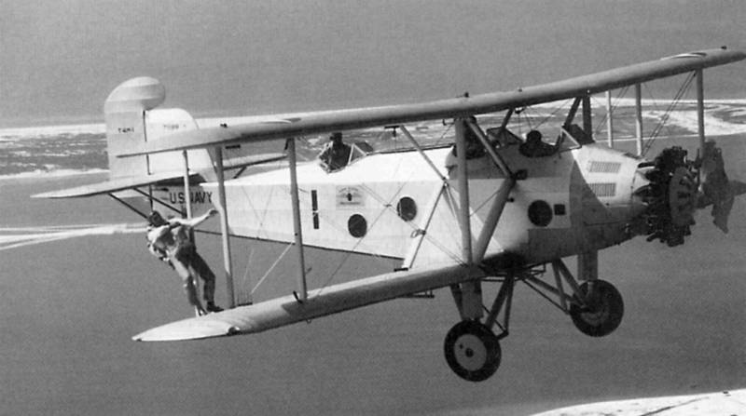
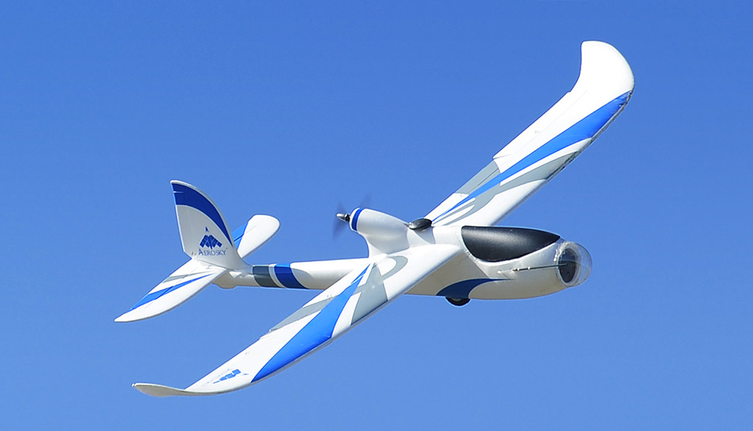
Entry into Civil Airspace
UASs growing cheaper
New requirement to ‘sense and avoid’
Demands location-sense and map-sense
https://sep.yimg.com/ay/yhst-17210252890263/aerosky-robosurfer-uav-glider-plane-4-channel-kit-2m-wingspan-3.jpg
Notes:
Contains: What exactly we plan to speak about

Slide 5
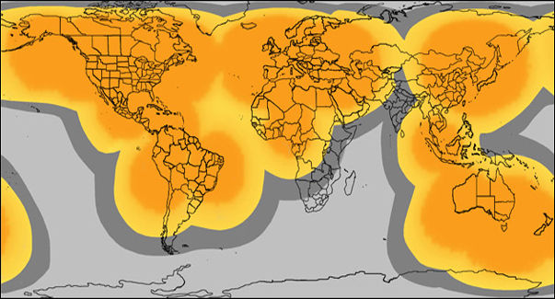
Why GPS is Objectively Excellent
http://www.gpsfortoday.com/wp-content/uploads/2009/09/spot-gps-tracking-device-coverage-map.jpg
Notes:
Contains: What exactly we plan to speak about

Slide 6
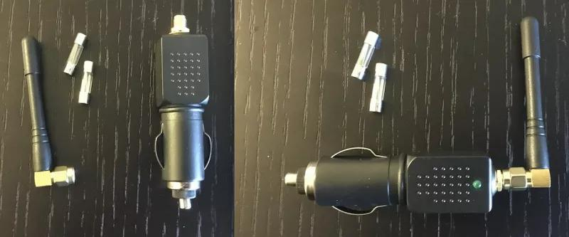
… but not perfect
GPS is incredibly easy to counter with a simple and cheap technology
The US is developing a system named NAVWAR aimed at disrupting enemy GPS signals.
VHF signals can interfere
Ionosphere disruption “scintillation”
Jamming, Spoofing, and Meaconing
"Federal Radionavigation Plan 1999," U.S. Department of Defense and U.S. Department of Transportation, December 1999. Accessed June 14, 2018. https://rosap.ntl.bts.gov/view/dot/8892/dot_8892_DS1.pdf?
“'Vulnerability Assessment of the Transportation Infrastructure Relying on the Global Positioning System,” tech. Rep., John A. Volpe National Transportation Systems Center, 2001. Accessed June 14, 2018. https://www.navcen.uscg.gov/pdf/vulnerability_assess_2001.pdf
Hill, Kashmir. "Jamming GPS Signals Is Illegal, Dangerous, Cheap, and Easy." Gizmodo. July 24, 2017. Accessed June 14, 2018. https://gizmodo.com/jamming-gps-signals-is-illegal-dangerous-cheap-and-e-1796778955.
Notes:
Contains: What exactly we plan to speak about

Slide 7
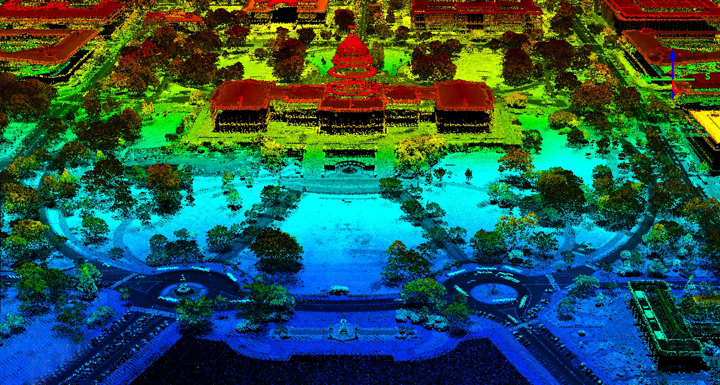
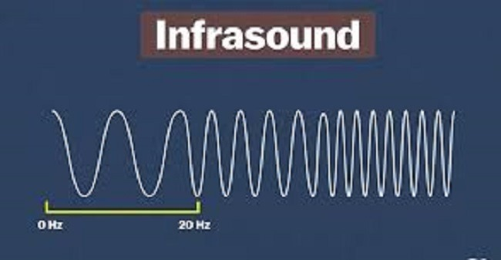
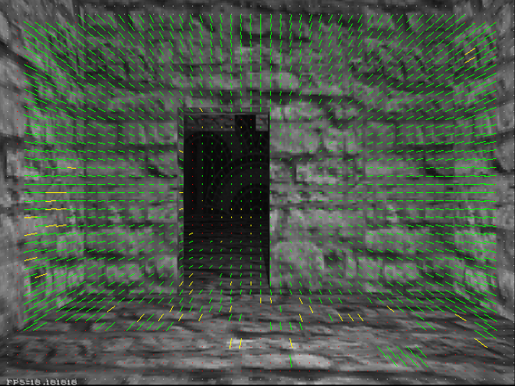
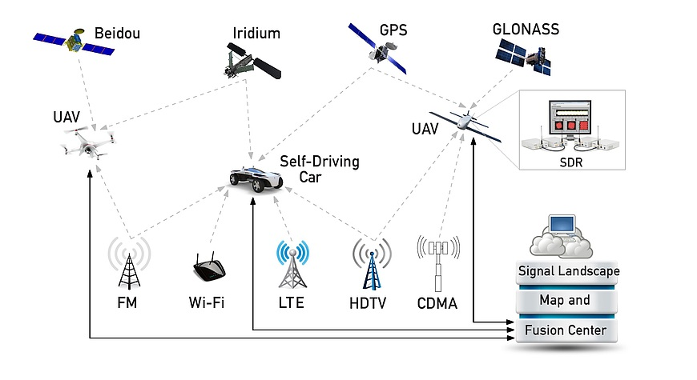
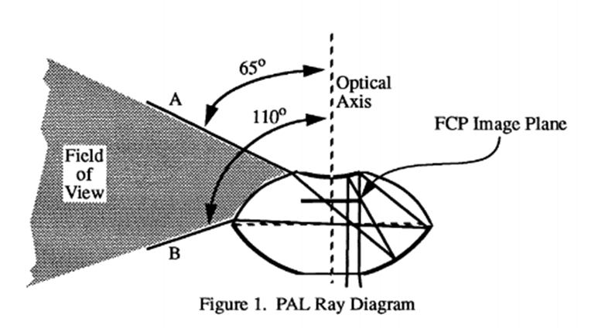
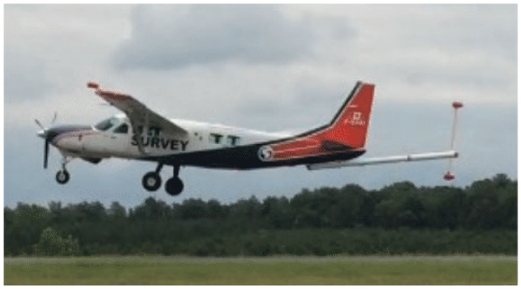
Alternatives to GPS Navigation
Inertial Navigation Systems
LiDAR
Infrasound
Signals of Opportunity
Optic Flow
Fingerprinting
Magnetometry
PALAD
Notes:
Contains: What exactly we plan to speak about

Slide 8
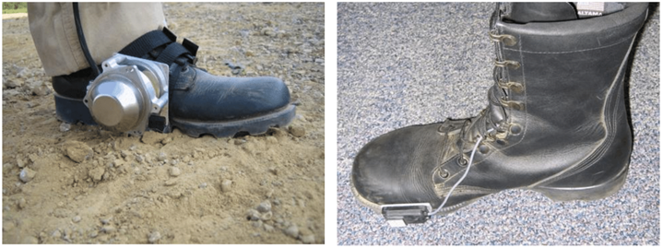
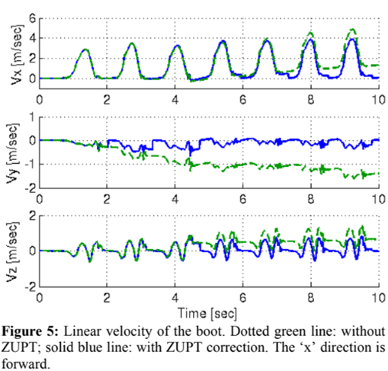
Inertial Navigation Systems
Use passive sensors to calculate the user’s position
Accelerometer drift problems
Zero Velocity Update (ZUPT) implementation
Less than 2% error in true location over a 15 minute walk
Ojeda, Lauro and Borenstein, Johann “Non-GPS navigation with the personal dead-reckoning system.” 2007. Accessed June 15, 2018. https://doi.org/10.1117/12.718691

Slide 9
LiDAR Navigation
Used primarily for SLAM
Creates accurate depth maps using pulsed light
Pro: penetrative, precise
Con: active, expensive
R. Li, J. Liu, L. Zhang and Y. Hang, "LIDAR/MEMS IMU integrated navigation (SLAM) method for a small UAV in indoor environments," 2014 DGON Inertial Sensors and Systems (ISS), Karlsruhe, 2014, pp. 1-15.
Notes:
Contains: What exactly we plan to speak about

Slide 10
Infrasound Navigation
Low frequency sound able to travel long distances
Used by homing pigeons to home
Current experiments show promise but no current success
Pro: Would work everywhere Con: Doesn’t work anywhere
Bauer, Riley, Shannon Nolet, and Saad Biaz. "A Novel Approach to Non-GPS Navigation Using Infrasound." Brat Monthly, February 02, 1998, 0-1.

Slide 11
Signals of Opportunity
Signals of Opportunity Navigation
Chunpeng Yan and H. Howard Fan, "Asynchronous differential TDOA for non-GPS navigation using signals of opportunity," 2008 IEEE International Conference on Acoustics, Speech and Signal Processing, Las Vegas, NV, 2008, pp. 5312-5315.

Slide 12
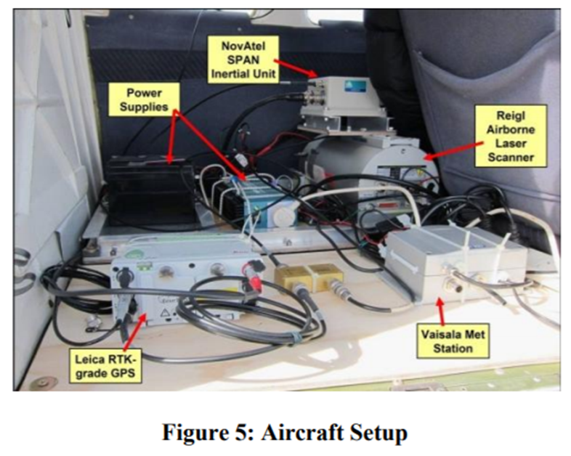
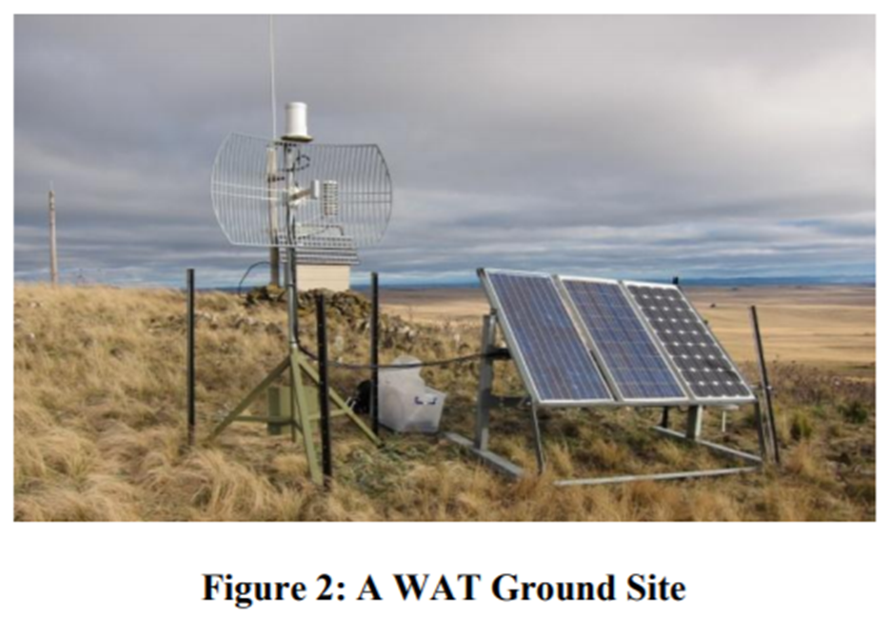
Network Triangulation
Ultra High Accuracy Reference System (UHARS)
Large Antennas with 30 mile radius
LocataNet (contract developed a system of TimeLoc, keeping all the wide area synced to Nanosecond-accurate time
Known-point initialization to resolve ambiguous GPS references
Angelo Trunzo, 746th Test Squadron, USAF and John Amt, Locata Corporation ION GNSS 2011, Portland, Oregon, 23 September 2011

Slide 13
Optical Flow
Optical Flow Navigation
Timizer, Selim, “Optical Flow Based Robot Navigation," 2001 Internal Publication, MIT
Notes:
TODO: Find what to say here. Also the switch from Austin -> Harrison should occur either before this slide or immediately after it.

Slide 14
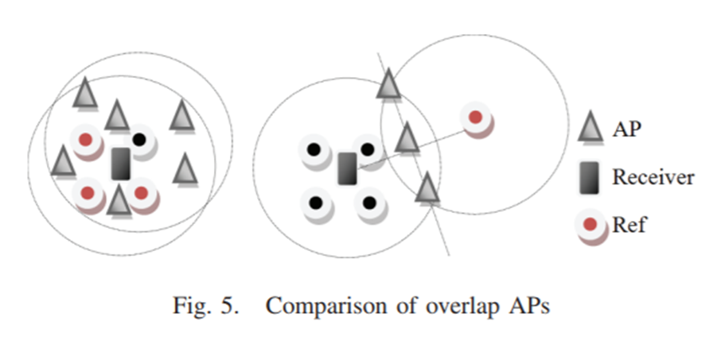
Fingerprinting Navigation
Training Phase
Implementations
RSS
Computer Vision
Magnetometer
Comparison Phase
“Position estimation”
Many algorithm approaches
WKNN or weighted k-nearest neighbor
Neural Network
SENIL
Extracts fingerprints from floor plans
Much work has been done to reduce the number of fingerprints size to then reduce its time to compare
X. Wang, J. Qiu, S. Ye and G. Dai, "An advanced fingerprint-based indoor localization scheme for WSNs," 2014 9th IEEE Conference on Industrial Electronics and Applications, Hangzhou, 2014, pp. 2164-2169.
doi: 10.1109/ICIEA.2014.6931530
Zain Bin Tariq, Dost Muhammad Cheema, Muhammad Zahir Kamran, and Ijaz Haider Naqvi. 2017. Non-GPS Positioning Systems: A Survey. ACM Comput. Surv. 50, 4, Article 57 (August 2017), 34 pages. DOI: https://doi.org/10.1145/3098207

Slide 15
Magnetometry Navigation
Use a preloaded magnetic anomaly map which was surveyed previously
3 year old map
Constraint of having to fly at low altitudes
Reported 13m accuracy
Favorable conditions
High cost of sensors
15,000 to 25,000
optically-pumped scalar magnetometers
A. Canciani and J. Raquet, "Airborne Magnetic Anomaly Navigation," in IEEE Transactions on Aerospace and Electronic Systems, vol. 53, no. 1, pp. 67-80, Feb. 2017.

Slide 16
Panoramic Annular Lens Attitude Determination
System of Determining in the attitude (directional angle) on a satellite
Use of a Panoramic Annular lens
Reflect and refract light
Full 360 degree view of the surroundings
Fairly large at 50 ft. diameter
Mark A. Stedham, Partha P. Banerjee “Panoramic annular lens attitude determination system (PALADS)” 1995. Accessed June 14, 2018. https://doi.org/10.1117/12.211498

Slide 17
Pro/Con of Prior Methods
 | Universality | Size | Cost | No Premap | Passive | UAV-Ready | Score
LiDAR | 0 | 1 | 1 | 1 | 0 | 1 | 4
Infrasound | 1 | 0 | 1 | 0 | 1 | 0 | 3
Signals | 0 | 0 | 0 | 0 | 1 | 1 | 4
Optical Flow | 1 | 1 | 0 | 0 | 1 | 1 | 4
Fingerprinting | 1 | 1 | 1 | 0 | 1 | 1 | 5
Magnetometry | 1 | 0 | 0 | 0 | 1 | 0 | 2
PALAD | 1 | 0 | 1 | 1 | 1 | 0 | 4
Astronav | 1 | 1 | 1 | 1 | 1 | 1 | 6

Slide 18
Celestial Navigation
Steps:
Take picture, and time
Identify stars
Determine relation between spheres
Relate star position and angle to current position

Slide 19
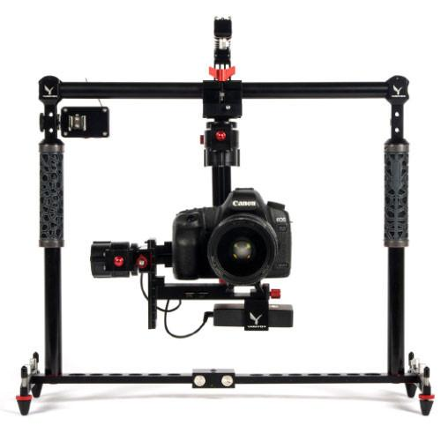
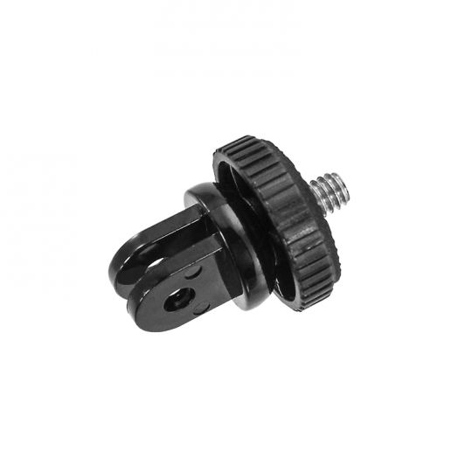
Camera Positioning
Gimbal
Mount

Slide 20
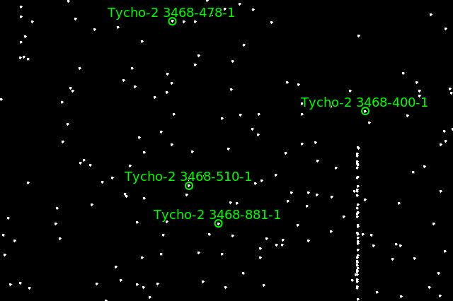
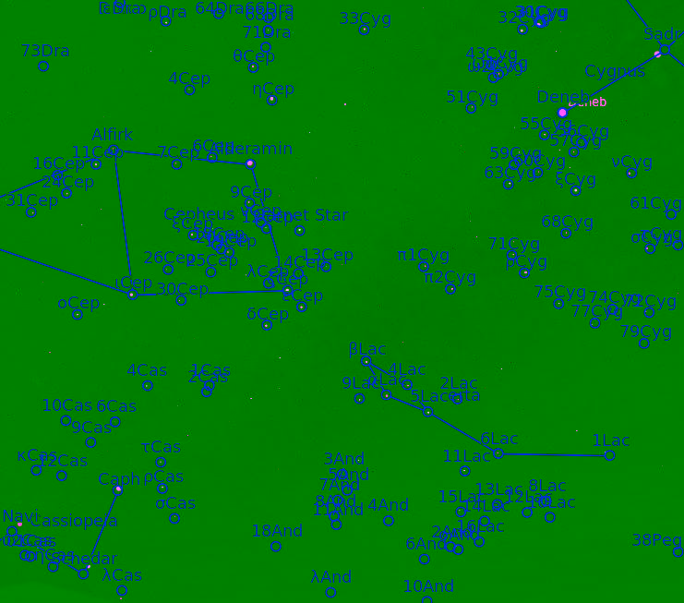
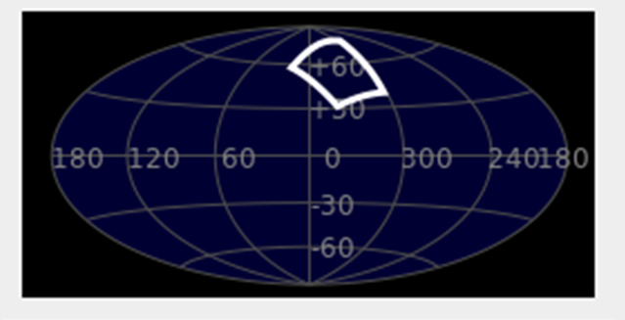
We use Astrometry.net to analyze images of starfields to find named instance stars
The algorithm relies on prior knowledge of where the stars are in the sky
Sloan Digital Sky Survey (yearly release)
Builds “quads” which are groupings of 4 stars
2 most distant points forming an axis
2 remaining star location about that axis are hashed and stored in a database
Bayesian decision of passing the is this a viable “quad”
Expectation of at least 1 million hashes for the entire night sky
Outputs out the RA and DEC of the input image
Capture from Astrometry.net’s Gallery
Dustin Lang, David W. Hogg, Keir Mierle, Michael Blanton, Sam Roweis. “Astrometry.net: Blind astrometric calibration of arbitrary astronomical images.” 2009. Accessed June 14, 2018. https://arxiv.org/pdf/0910.2233.pdf
Screenshot from Sellarium uploaded into nova.astrometry.net

Slide 21
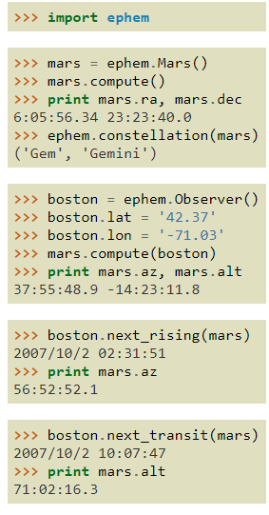
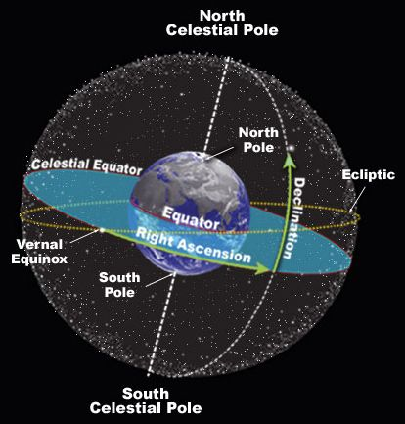
PyEphem is a Python library used to constrain the celestial sphere using absolute time

Slide 22
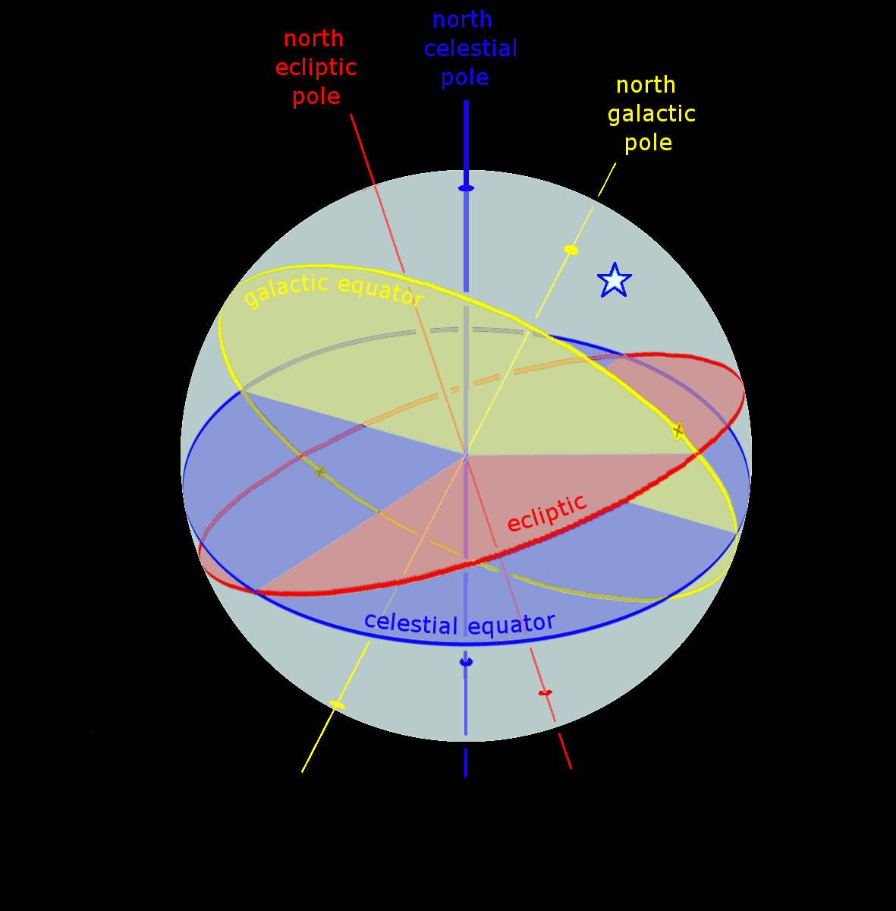
Observer position can now be found using zenith imaging and celestial coordinates of instance stars

Slide 23
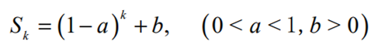
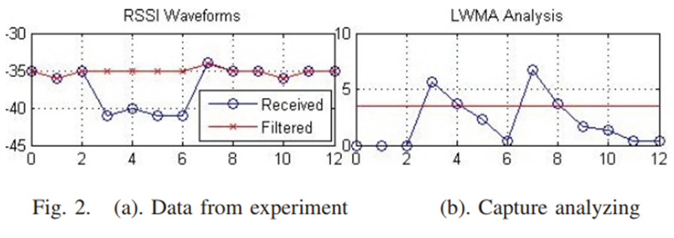
Filtering
Kalman Filtering
Memory fading unscented
Max error reduced by 21.4% and mean error reduced by 7.1%
Matrices to filter sooth position estimations from raw data
Exponential Weighted Moving Average (EWMA)
Linearly Weighted Moving Average (LWMA)
Less computationally complex
Remove noise and human interference
X. Wang, J. Qiu, S. Ye and G. Dai, "An advanced fingerprint-based indoor localization scheme for WSNs," 2014 9th IEEE Conference on Industrial Electronics and Applications, Hangzhou, 2014, pp. 2164-2169.
doi: 10.1109/ICIEA.2014.6931530
F. Si, Y. Zhao and X. Zhang, "Memory fading unscented Kalman filter and its application in navigation by stellar refraction," 2017 IEEE Aerospace Conference, Big Sky, MT, 2017, pp. 1-8. Accessed Jun 15, 2018. http://ieeexplore.ieee.org/stamp/stamp.jsp?tp=&arnumber=7943569&isnumber=7943554

Slide 24
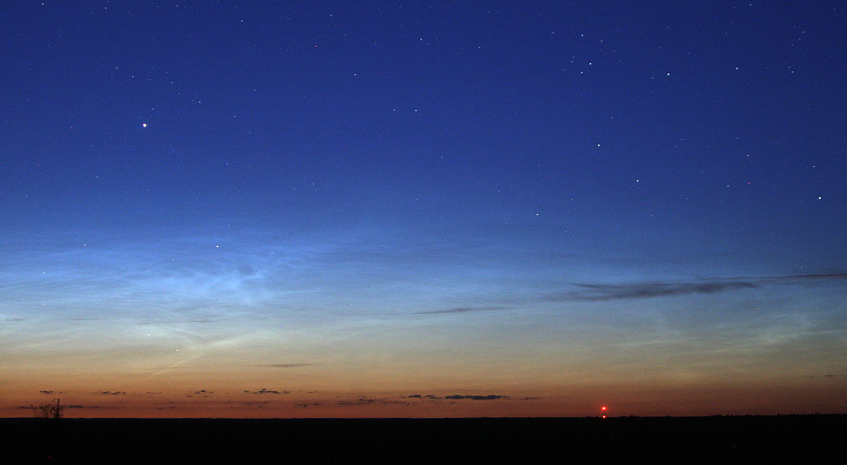
Potential Points of Failure
Magnification of error
Astrometry.net
Runtime speed
Accuracy
Calculations
Day and twilight analysis
Will there be enough stars
Can this work in the daytime?
Photography quality
Capture Speed
ISO number,
Aperture and focal length
Vehicular Attitude vs. Photography
https://stgreenie.wordpress.com/2014/10/05/star-stuck/

Slide 25
Review
Importance of UAVs
UAV Navigation
Non-GPS Navigation
Available tools
Celestial-Inertial Navigation

